Slide 1
Mutual Fund Data Analysis
Capstone Project Group 4
16 August 2024 TEAM: AARUSH GOYAL
DHARSHIN B
SANIYA MANWATKAR
GitHub Repository Link

Slide 2
Agenda
Problem Statement
Solution Approach
AWS solution architecture
Extracting the historic data
EDA on raw data
ETL on raw data
EDA on curated data
Data Profiling & QC Check
Extracting daily level data
Report summary of extraction
Pushing curated historic data and daily data to Redshift
Exchange rates data for currency conversion
Connection between Redshift and Quicksight
Business Insights & Visualization on Quicksight

Slide 3
Problem Statement & Objectives
Use the Indian Mutual Fund (https://www.mfapi.in/) API to get the Indian mutual fund data. Extract the entire historical Mutual fund data for all funds and build a mechanism to update the missing data daily.
Perform data analysis.
Load the entire into a Relational Database. Build data load summary reports to validate the data loads.
Develop an ETL pipeline to pull the updated data from these Api's daily at a fixed time.
The jobs should have failure alerts and should also daily load summary report over email.
Build a live dashboard to show the various trends across Mutual Funds along with a currency convertor.

Slide 4
Solution Approach
Fetch the historical mutual fund from the API using a glue job and store it in S3 bucket.
Perform a quality check on the fetched data and perform data cleansing.
Exploratory Data Analysis can be performed on this data to analyse trends in the data.
Upload the historical data to a relational database (Redshift).
Daily data of mutual fund can be extracted from the API using another glue job with scheduler and loaded into the database.
The failure alert for this glue job and data load report are done using EventBridge, Lambda and SNS.
Quicksight is used to fetch data from the database and create dashboards which gives various insights retrieved from the data.

Slide 5
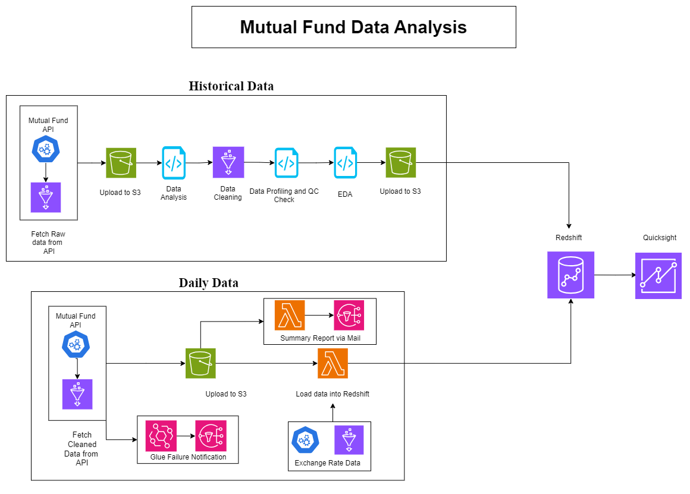
AWS Solution Architecture

Slide 6
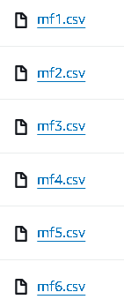
Historic Data Extraction From API
S3 Bucket
Glue Job
Extraction
Output
Created an S3 Bucket to store the data.
Created a folder specifically for storing original Historic Data.
Created glue job to fetch the historical data from API.
The entire process was done by slicing the dataset based on scheme codes.
The scheme codes in the API are fetched and added to a list.
Based on the sliced list of scheme codes, the data and meta data available in the API are fetched and stored in the S3 bucket.
Historic data files

Slide 7
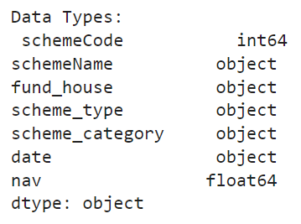
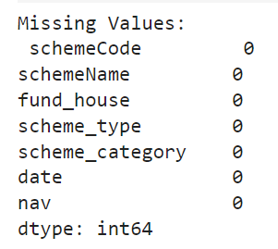
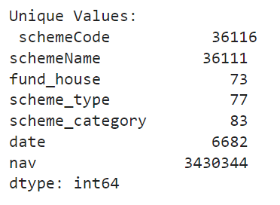
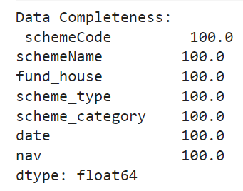
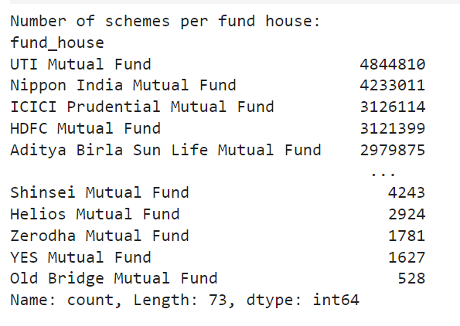
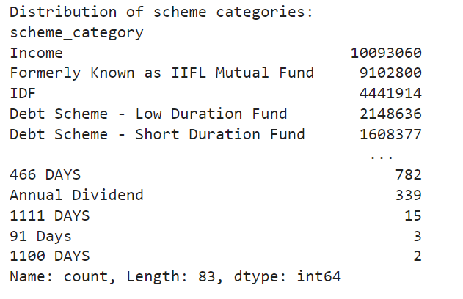

Exploratory Data Analysis On Raw Data
This analysis was performed on jupyter notebook.
Merged the separate csv files into one dataframe.
Checked for Duplicates and Null values.
Checked the data type of each column.
Calculated unique values.
Checked for number of schemes in each fund house.
Checked the distribution of data for various columns.

Slide 8
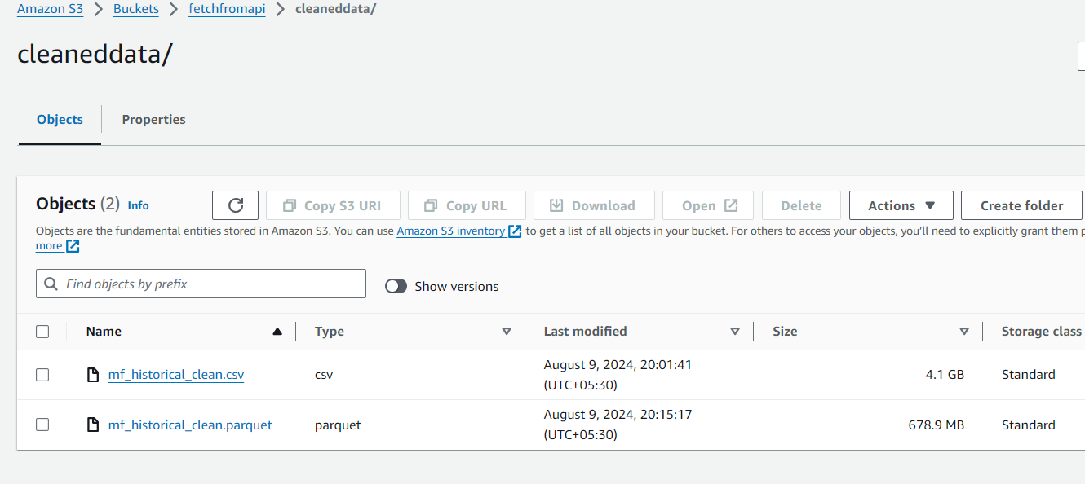
Cleaning of Raw Data
Data Cleansing
Remove duplicate rows and rows with any missing values.​
Convert the date column to datetime format.​
Sorted the DataFrame in descending order by the date column.
Categorized the scheme category and scheme type columns using custom functions.
Storing The Data
Cleaned files in S3 bucket
Saved the cleaned dataframe as both CSV and Parquet files.
Upload the cleaned CSV file to the specified S3 bucket.

Slide 9
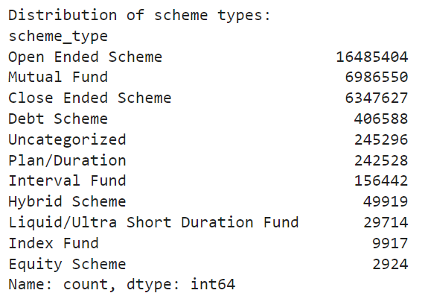
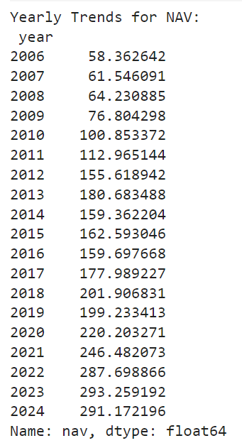
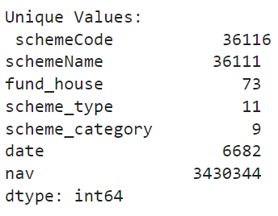

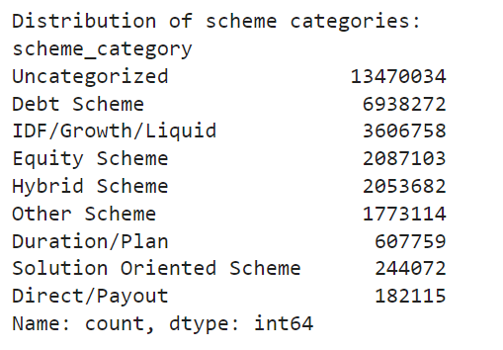
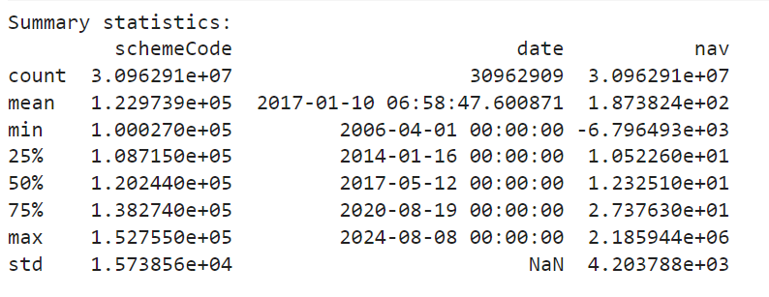
Exploratory Data Analysis On Cleaned Data
This analysis was performed on jupyter notebook.
Checked for Duplicates and Null values.
Checked the data type of each column.
Checked for number of schemes for each scheme sub-category .

Slide 10
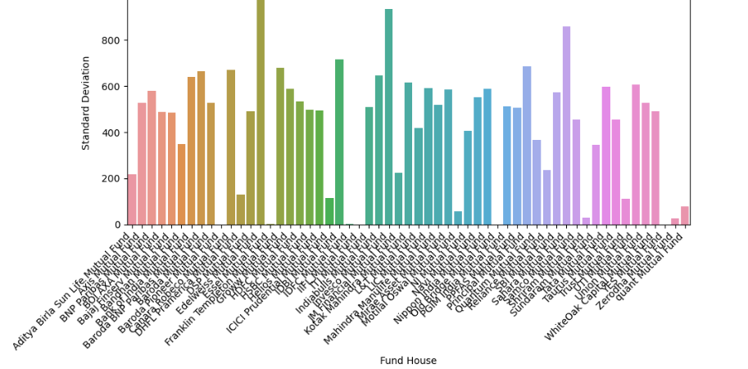
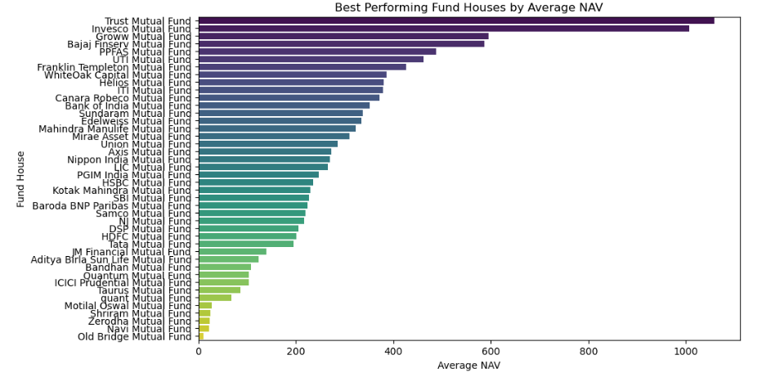
Exploratory Data Analysis (Cont.)
Volatility of Fund Houses
The standard deviation of NAV values was plotted to find the volatility of each fund house. Lesser the standard deviation, lesser the risk involved in that fund house.
Fund House Performance
This graph gives insights about the performance of various fund houses based on the average NAV.
Note: Since the dataset was very large, EDA has been performed only for data from Jan 01,2024.

Slide 11
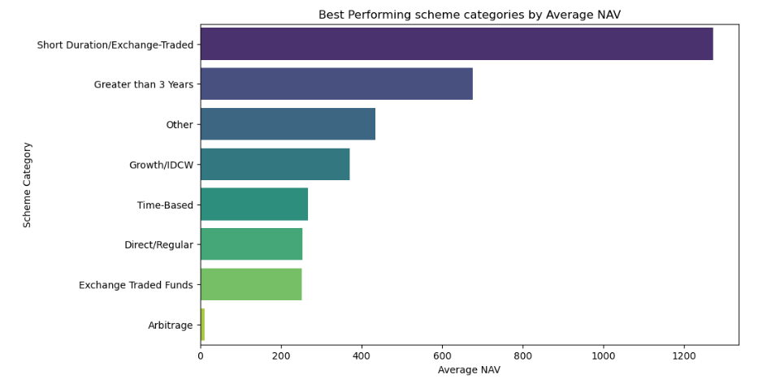
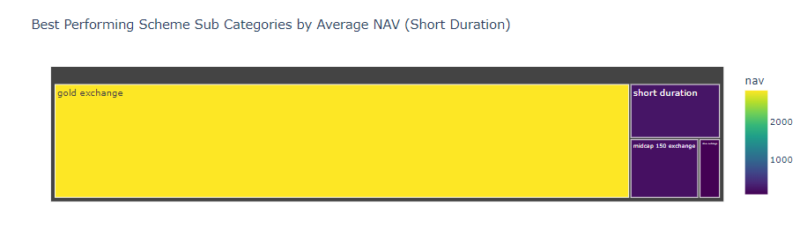
Exploratory Data Analysis (Cont.)
Scheme Category Performance
This graph gives insights about the best performing scheme categories of mutual fund.
Subcategory of Schemes
We filtered out the best performing category from the previous graph and plotted a tree map to show the distribution of various subcategories.

Slide 12
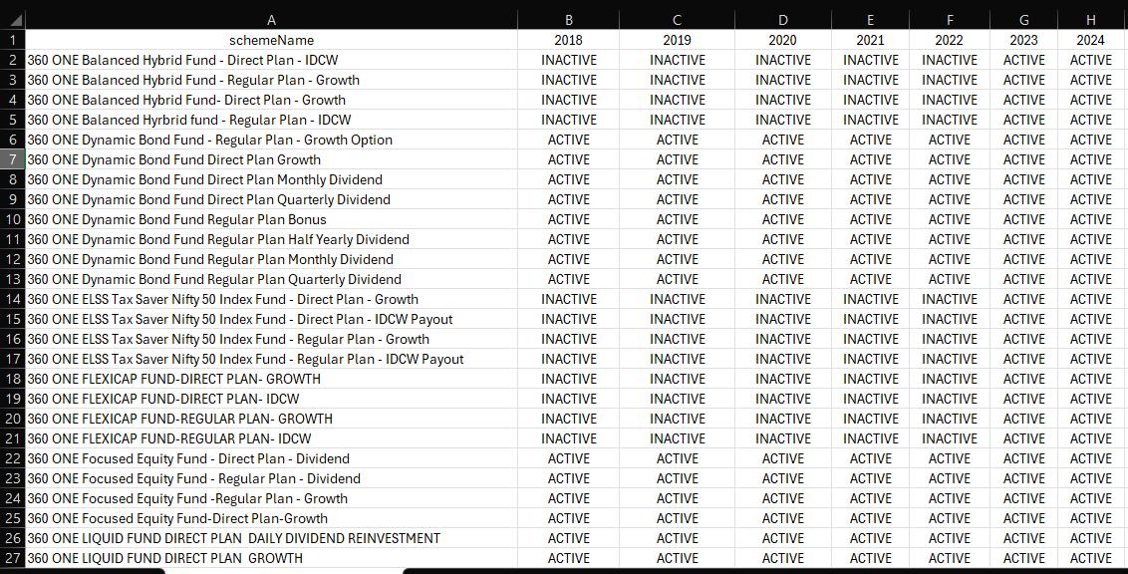
Exploratory Data Analysis (Cont.)
Scheme Activity Status
A table to check the activity status of a scheme starting from 2018 to 2024. This table was exported into a csv file and merged with the data.

Slide 13
Data Dictionary
Column Names | Description | Data Type | Sample Values | Unique Values | Classification | Range | Note
schemeCode | Code for a Mutual Fund Scheme | Integer | 100027 | 36116 | Categorical | 100027 to 152755 | Scheme Codes have only 6 digits
schemeName | Name of the mutual fund scheme | String | Grindlays Super Saver Income Fund-GSSIF-Half Yearly Dividend, BARODA ELSS 96 - Plan A - IDCW | 36111 | Categorical | -
fund_house | The name of the mutual fund house or asset management company managing the scheme. | String | Standard Chartered Mutual Fund, Baroda Mutual Fund | 73 | Categorical | -
scheme_type | The type of the mutual fund scheme (e.g. Growth, Dividend). | String | ['Mutual Fund', 'Open Ended Scheme', 'Close Ended Scheme', 'Interval Fund', 'Debt Scheme'] | 11 | Categorical | - | Scheme Type values has been categorized into 11 categories
scheme_category | The category of the mutual fund scheme, which defines the type of investments the fund primarily makes (e.g. Large Cap, Mid Cap). | String | ['IDF/Growth/Liquid', 'Debt Scheme', 'Other Scheme', 'Uncategorized', 'Hybrid Scheme'] | 9 | Categorical | - | Scheme Category values has been categorized into 9 categories
date | The date for which the NAV (Net Asset Value) is reported. | Date | 29-05-2008 | 6682 | Numerical | 2006-04-01 to 2024-08-08 | Date will be updated daily
nav | The Net Asset Value of the mutual fund scheme on the specified date. | Float | 10.7205 | 3430344 | Numerical | -6796.4926 to 2185944.3903 | Mean NAV= 187.382 Median NAV= 12.3251

Slide 14
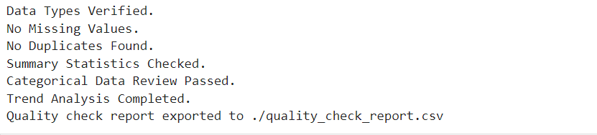
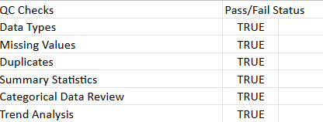
QC Checklist
Prepared a Quality Control Checklist for the cleaned data file on Jupyter Notebook.
The QC Checklist was printed as a csv file.
Output for QC Checklist in Jupyter Notebook and as a CSV File:

Slide 15
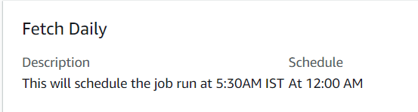
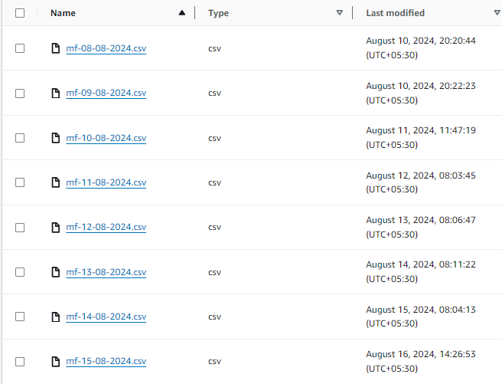
Daily Data Extraction From API
S3 Bucket
Glue Job
Output
Created an S3 Bucket to store the daily data extracted from the API.
Created a folder specifically for storing this daily data.
Created a Glue Job to fetch and clean the daily data from the API.
The Glue Job is Scheduled to run daily at 12:00 AM UTC.
Glue Job Scheduling.
Cleaned daily data files in S3.

Slide 16
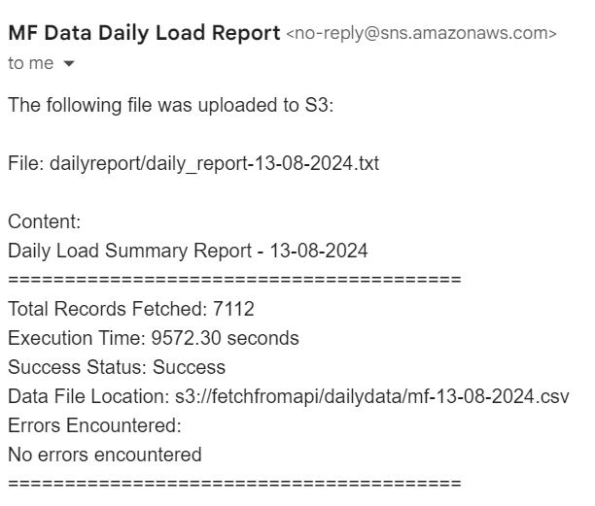


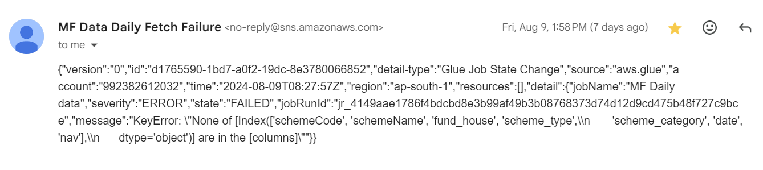
Glue Failure Notification & Data Load Report
A SNS topic is created and connected with Amazon Event Bridge to notify the Glue Job Failure via email, if the case arises
A lambda function is connected with another SNS topic to provide the daily data load report of the daily fetched data from the API through email.

Slide 17
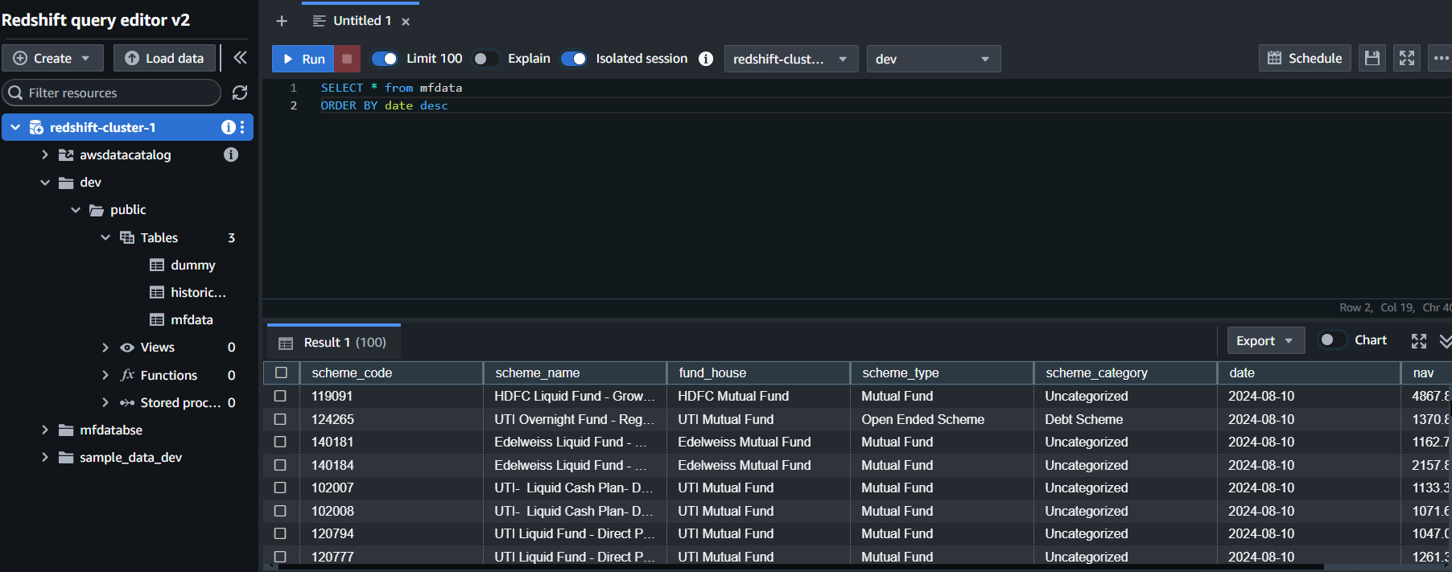
Historic Data load into Redshift
A Redshift cluster was created for storing the entire data.
The cleaned Historical data file is uploaded on the Redshift from the S3 Bucket in a table.
Another table was created to store the data from 2018 till date for analysis purposes.

Slide 18
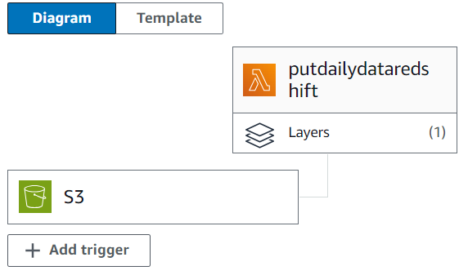
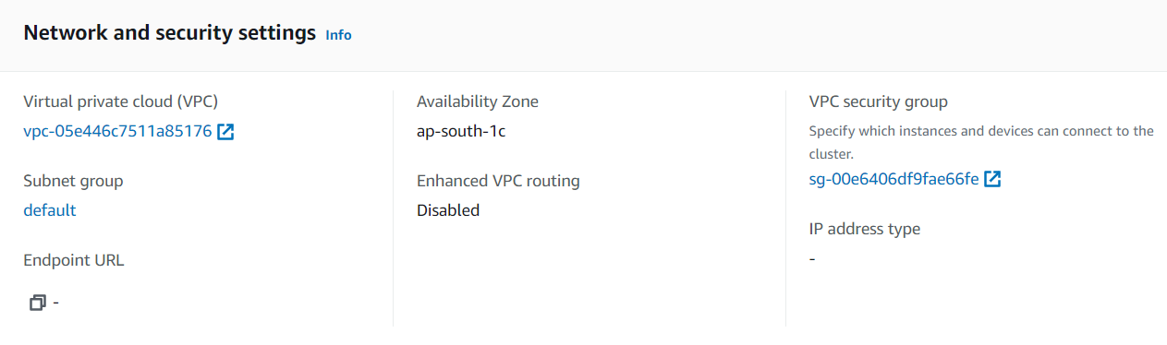
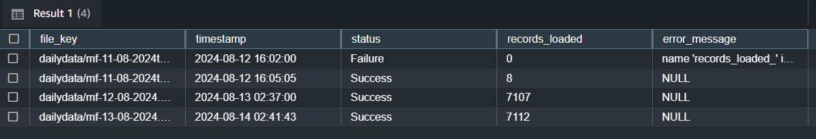
Daily data load into Redshift using Lambda
Daily Automated Data Transfer
Data Loading & Load Report
A Lambda function is triggered daily to extract files from an S3 bucket and load it into Redshift table
The lambda is connected to the redshift cluster using the default VPC.
This automated pipeline ensures consistent and efficient data integration into Redshift for further analysis.
Every time when the daily data is loaded, a load report is generated and stored into a table in the database.

Slide 19
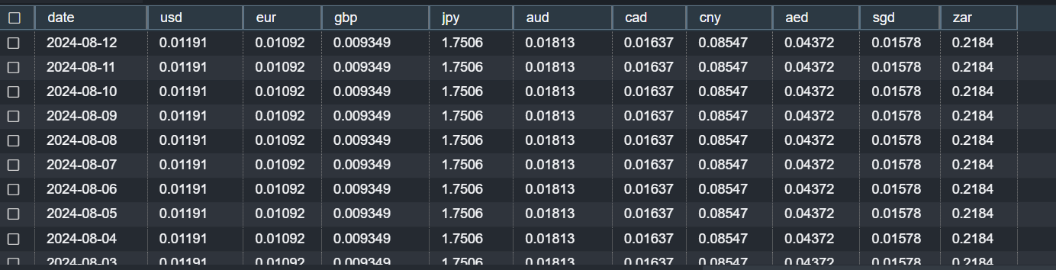
Exchange Rate Data
To implement the currency convertor in dashboard, exchange rates data of 10 popular currencies have been fetched from Exchange Rate API starting from Jan 01,2018 till date using a glue job.
Daily updating of exchange rate data has been implemented using a glue job and the data is uploaded to a redshift table using lambda trigger.
The free version of this API has very limited number of API calls per month and hence it is difficult to get daily data on a regular basis. This can be solved if we use the paid versions of this API.
Multiplying the value of exchange rates with the NAV value will give NAV in different currencies.

Slide 20
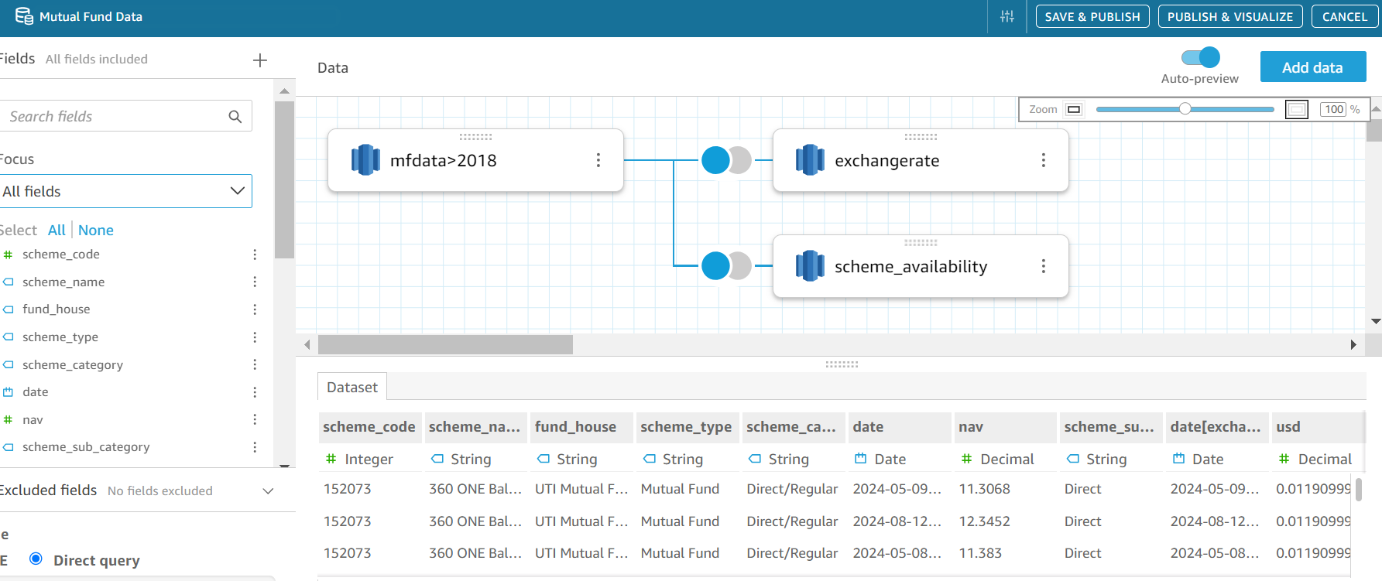
Redshift to Quicksight
The redshift database has been imported into quicksight as a dataset.
Tables of the redshift database were merged using joins to form a complete dataset.

Slide 21
Calculated Fields of Quicksight
Calculated Field | Description
0,1,3,5-year NAV | Returns the average NAV value in 2024​, 2023, 2021, 2019 respectively. (4 different fields)
Active Scheme | Returns the list of active schemes in a particular year. Created using the scheme activity status csv file generated during EDA
Assets | Categorizes the schemes into Equity, Debt, Hybrid, Solution-Oriented and other assets.
Choose year | To return the average NAV values of a chosen year. This works along with a parameter.
Date with Axis | To determine the dimension (Year/Quarter/Month/Day) of an axis based on a parameter.
Day, Month, Quarter, Year | To extract the respective part of the date field. (4different fields)
NAV(Exchange) | Enables currency conversion based on a parameter by multiplying the NAV value with exchange rates.
Return 1,3,5 Year | Gives the return of a scheme after 1 year, 3years and 5 years respectively. (3 different fields)
Returns | Gives the return value of a chosen time frame based on the parameter.
Volatility | Classifies the schemes into Low risk, Moderate risk and High-risk schemes.

Slide 22
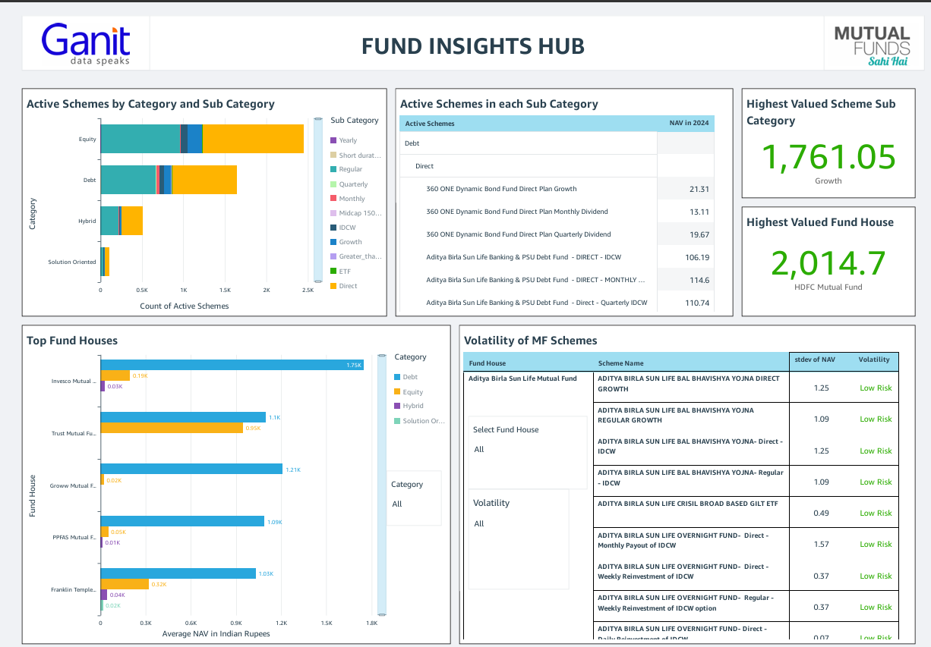
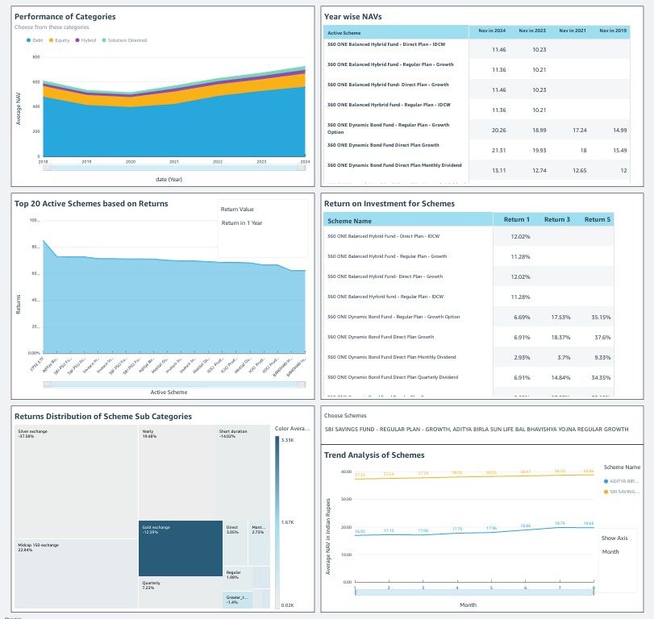
Quicksight Dashboard

Slide 23
Business Insights
The "Fund Insights Hub" dashboard is designed to assist individuals considering mutual fund investments. The dashboard offers insights such as:
The highest valued fund house and scheme category as of today.
Distribution of scheme subcategories within each category.
A list of active schemes each year since 2018, allowing users to check the consistency of schemes.
Top-performing fund houses for each category.
Analysis of the risk factors associated with various schemes.
Performance comparison across different categories.
Performance comparison of individual schemes.
Return on Investment (ROI) analysis.

